Slide 1

CS 410 Course Project
Reproducing paper:
Mining Causal Topics in Text Data: Iterative Topic Modeling with Time Series Feedback (Kim et al 2013)
Michael McClanahan
Online MCSDS
NetID: mjm31

Slide 2
Overview
Project Objectives
Installation and Use
Example Results
Discussion

Slide 3
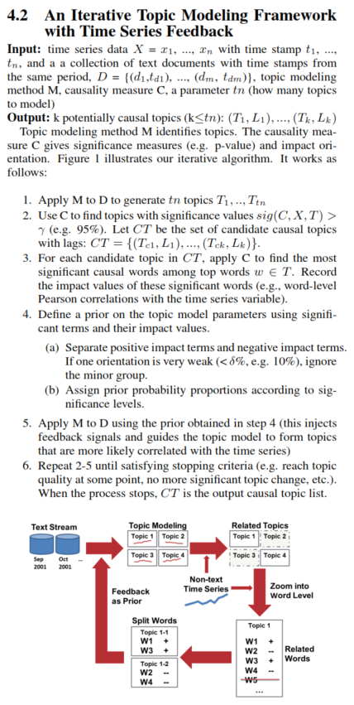
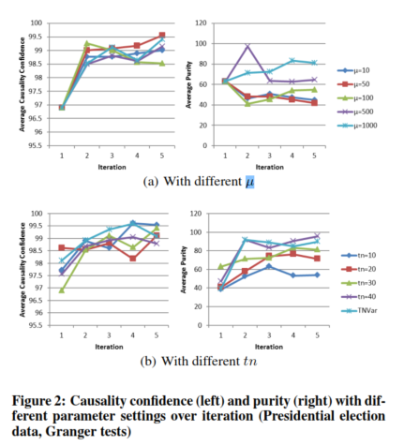
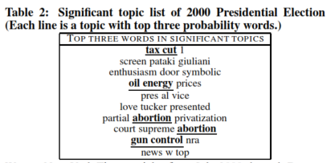
Project Objectives
Implement the Iterative Topic Modeling framework with Time Series Feedback (ITMTF) outlined by Kim et al 2013:
Mining Causal Topics in Text Data: Iterative Topic Modeling with Time Series Feedback (Kim et al 2013)
Specifically, this is a Python3 implementation that attempts to use the LDA topic modeling implementation from Gensim
Perform the paper’s 2000 Presidential Election experiment
Attempt to replicate results from Table 2 and Figure 2(b)
The experiment for Figure 2(a) was not attempted because Gensim’s LDA model implementation does not have a µ parameter

Slide 4
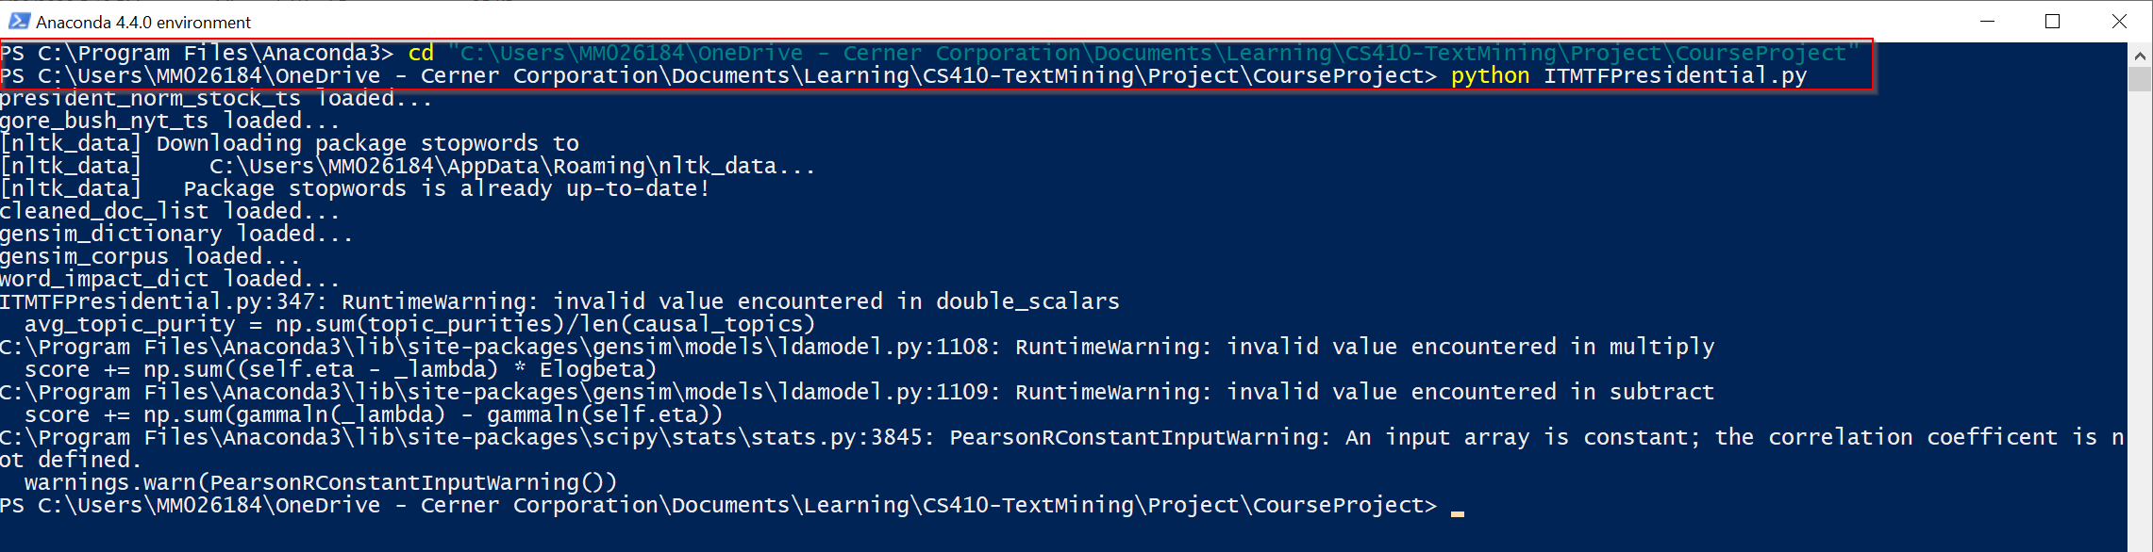
Installation and Use
If neccessary, install Python3
Then install the following project dependencies using pip
pandas - https://pandas.pydata.org/pandas-docs/stable/getting_started/install.html
gensim - https://radimrehurek.com/gensim/
nltk - https://www.nltk.org/install.html
scipy - https://www.scipy.org/install.html
numpy - https://numpy.org/install/
Clone the project repository, making a local copy of all files. This is also the working directory for the code, all of which is implemented in ITMTFPresidential.py. All neccessary objects to reproduce my results are in this repository and automatically consumed by the script.
Navigate to your local directory to which the project was cloned and run the script with the following command:
python ITMTFPresidential.py

Slide 5
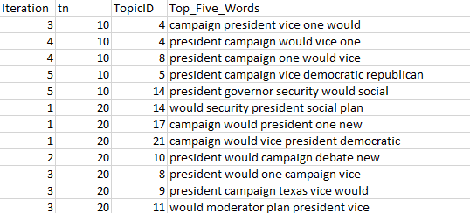
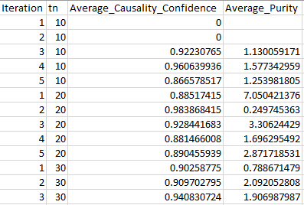
Installation and Use
Analyze resulting csv files
causal_topic_words.csv – contains the top five words for causal topics identified during each IMTMF iteration for each of 5 different IMTMF runs , each with a different initial number of topics identified for LDA
itmtf_stats.csv – contains neccessary average causality confidence and purity statistics for each iteration of the 5 different IMTMF runs

Slide 6
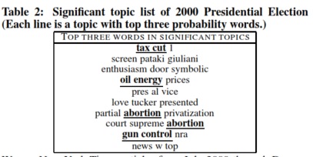
Example Results
Top Five Words in Significant Topics
president campaign vice democratic republican
president governor security would social
president campaign would vice voters
president would one vice campaign
president campaign vice would texas
campaign gov republican new state
would president campaign people one
vidal clinton campaign president vice
campaign president would oil vice
president would campaign one time
oil president texas would percent
president campaign would vice republican

Slide 7
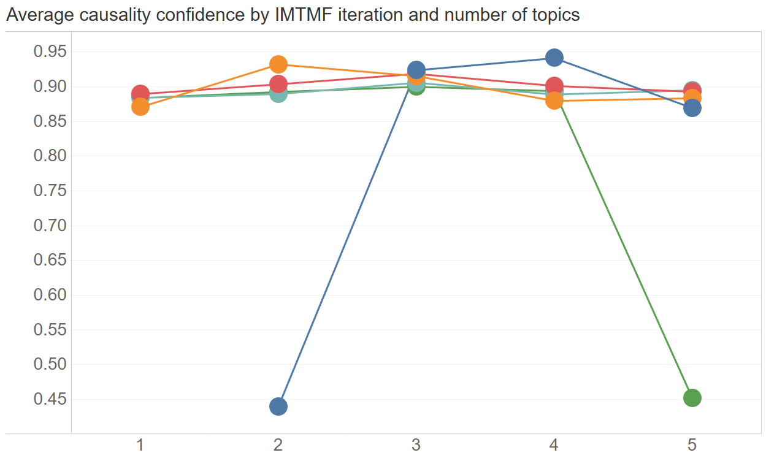
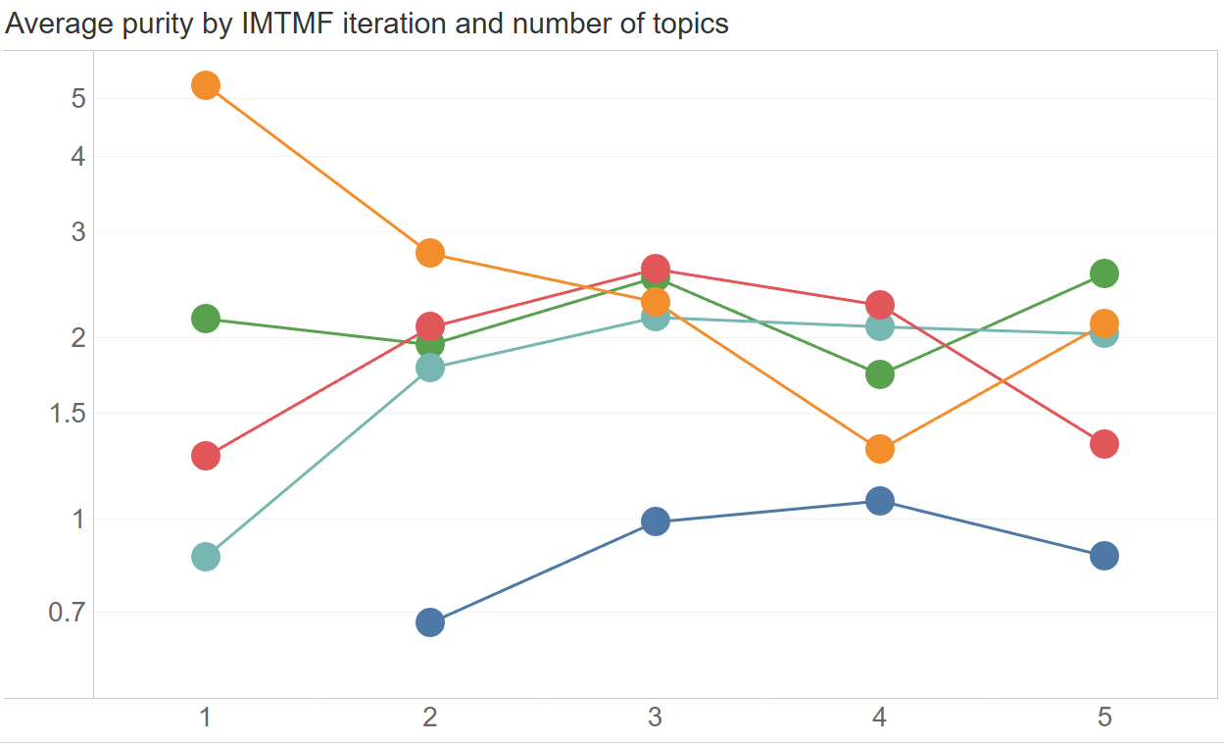
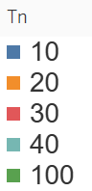
Example Results

Slide 8
Discussion
In general poorer this implementation’s results were poorer than what was noted in the paper
Improvements in causality confidence and purity were not observed with more iterations
Top words for causal topics seemed applicable, but not all that compelling or different from one another
Poorer results are likely due to differences in this implementation:
Lack of a background model – Although the paper doesn’t explicitly cite the use of a background model prior, results would imply they had one. My topics seem to have a lot more “background words” (ex: would).
Lack of a background could also be the a main reason for substantially lower purities with each iteration (0-5% vs 40-100%).
Lack of µ parameter – This is likely the reason that neither purity nor causality confidence were improved with each iteration, regardless of the number of topics to begin with. Using this parameter would have ensured that prior words (and topics) appeared with the next iterations results.

